Slide 1
Input Device: Barcode Reader

Slide 2
Barcode
A barcode (also bar code) is a machine-readable representation of information in a visual format on a surface
Originally barcodes stored data in the widths and spaces of printed parallel lines, but today they also come in patterns of dots, concentric circles, and hidden within images
A barcode is simply a graphical representation of a string of characters encoded such that it can be read by a barcode scanner.
A bar code consists of a series of parallel, adjacent bars and spaces.

Slide 3
Barcode
Bar codes provide a simple and inexpensive method of encoding text information that is easily read by inexpensive electronic readers. Bar coding also allows data to be collected rapidly and with extreme accuracy. A bar code consists of a series of parallel, adjacent bars and spaces. Predefined bar and space patterns or "symbologies" are used to encode small strings of character data into a printed symbol. Bar codes can be thought of as a printed type of the Morse code with narrow bars (and spaces) representing dots, and wide bars representing dashes.

Slide 4
Barcode Reader
Barcode reader decodes a bar code by scanning a light source across the bar code and measuring the intensity of light reflected back by the white spaces. The pattern of reflected light is detected with a photodiode which produces an electronic signal that exactly matches the printed bar code pattern. This signal is then decoded back to the original data by inexpensive electronic circuits. Due to the design of most bar code symbologies, it does not make any difference if you scan a bar code from right to left or from left to right.

Slide 5

Basic Barcode Structure
The basic structure of a bar code consists of a leading and trailing quiet zone, a start pattern, one or more data characters, optionally one or two check characters and a stop pattern.

Slide 6
Barcode History
The first barcode was developed in 1948 by three graduate students at Drexel Institute of Technology, Jordin Johanson, Bernard Silver and Norman Joseph Woodland. They filed for a U.S. patent in October 1949 and it was granted in 1952. Its implementation was made possible through the work of Raymond Alexander and Frank Stietz, two engineers with Sylvania, as a result of their work on a system to identify railroad cars (who were also granted a patent). It was not until 1966 that barcodes were put to commercial use and they were not commercially successful until the 1980s

Slide 7
Barcode Symbologies
Bar codes are like a printed version of the Morse code. Different bar and space patterns are used to represent different characters. Sets of these patterns are grouped together to form a "symbology". There are many types of bar code symbologies each having their own special characteristics and features. Most symbologies were designed to meet the needs of a specific application or industry. For example the UPC symbology was designed for identifying retail and grocery items and PostNET was designed to encode Zip Codes for the US Postal Service.

Slide 8
Morse Code
Morse code is a method of transmitting text information as a series of on-off tones, lights, or clicks that can be directly understood by a skilled listener or observer without special equipment. It is named for Samuel F. B. Morse, an inventor of the telegraph. Each Morse code symbol represents either a text character (letter or numeral) or a pro sign and is represented by a unique sequence of dots and dashes. The dot duration is the basic unit of time measurement in code transmission.

Slide 9
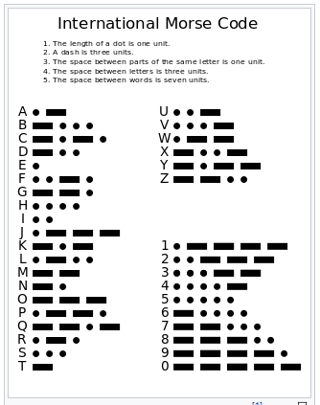
Morse Code

Slide 10
Barcode Symbologies (Continued)
The mapping between messages and barcode is called a symbology. The specification of a symbology includes the encoding of the single digits/characters of the message as well as the start and stop markers into bars and space, the size of the quiet zone required to be before and after the barcode as well as the computation of a checksum.

Slide 11
Barcode Symbolozies (Continued)
Linear symbolizes can be classified in the following
ways:
Continuous vs. discrete.
Two-width vs. many-width.
Fixed and variable length.

Slide 12
Barcode Symbologies (Continued)
A discrete symbology is one where each and every character encoded in the symbol may be interpreted individually without respect to the rest of the barcode. Such symbologies have characters that both start and end with a bar. Individual characters are separated by some amount of inter-character spacing. The intercharacter spacing carries no information-the only duty of the intercharacter spacing is to separate the characters.
A continuous symbology is one in which the individual characters of the symbology cannot be interpreted by themselves. This is due to the fact that characters start with a bar and end with a space. The final space is "terminated" by the starting bar of the next character. A character cannot be taken individually since, individually, there is no way to know how wide the last space is without knowing where the next character begins. Continuous symbologies normally implement some kind of special termination bar or termination sequence such that the last space of the last data character is terminated by the termination bar.

Slide 13
Barcode Symbologies (Continued)
A Two-Width symbology has spaces and bars that are either wide or narrow. This has the benefit of simplicity-once it is determine how wide a "narrow" bar or space is, anything over a certain width can be considered "wide." This allows for a large level of print tolerance in lower-quality printing conditions.
A Multiple-Width symbology is one which has bars and spaces that may be of 3 or more widths. The narrowest bar or space may be X in width, a medium-width space or bar may be 2X in width, and a wide bar may be 3X in width. Since there are more possible combinations available in a multiple-width symbology, data encoding is often more efficient and results in a tighter barcode. Multiple-width symbologies are usually continuous symbologies and are often scanned using edge-to-similar-edge decoding algorithms.

Slide 14
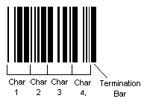
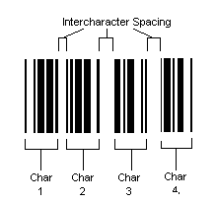
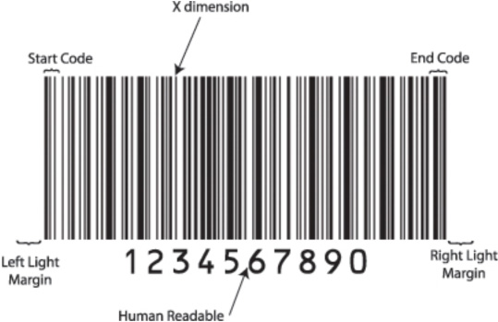
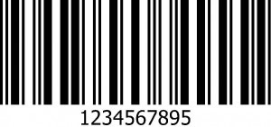
Barcode Symbologies (Continued)
Continuous
Discrete
Two-Width
Many-Width

Slide 15
Barcode Symbologies (Continued)
A fixed-length symbology is one which must, by definition, encode a certain number of characters or digits. For example, a UPC-A barcode always encodes 12 digits of data. An application may not encode less or more than the pre-defined fixed-length of 12 characters. The symbology itself defines the length of data.
A variable-length symbology is one which can carry a message of any length. For example, Code 128 may encode any number of characters that can reasonably fit physically in the printed barcode. The symbology itself does not define how many characters of data must be encoded.

Slide 16
Barcode Symbologies (Continued)
Some symbologies use interleaving. The first character is encoded using black bars of varying width. The second character is then encoded, by varying the width of the white spaces between these bars. Thus characters are encoded in pairs over the same section of the barcode.
Stacked symbologies consist of a given linear symbology repeated vertically in multiple.
There is a large variety of 2-D symbologies. The most common are matrix codes, which feature square or dot-shaped modules arranged on a grid pattern. 2-D symbologies also come in a variety of other visual formats.

Slide 17
Barcode Symbologies (Continued)
There are a variety of different types of bar code encoding schemes or "symbologies", each of which were originally developed to fulfill a specific need in a specific industry. Several of these symbologies have matured into de-facto standards that are used universally today throughout most industries. The symbologies supported by B-Coder, the TALtech Bar Code ActiveX control and the TALtech Bar Code DLLs are those most commonly used across all industries.

Slide 18
Barcode Symbologies (Continued)
Some Common Barcode Symbologies:
CODE 39 (Normal and Full ASCII versions)
UPC –A , UPC –E , and UPC Supplementals
EAN-8/ EAN-13, BookLand and EAN Supplementals
RSS-14
INTERLEAVED 2 OF 5
DISCRETE 2 OF 5
CODE 93
EAN/UCC 128

Slide 19
Barcode Symbologies (Continued)
POSTNET /Postal FIM Patterns
PDF417
BPO 4 State Code (British Post Office, Royal Mail Code)
DATA MATRIX
MAXICODE
AZTEC CODE
MSI/PLESSEY

Slide 20
CODE 39 (Normal and Full ASCII versions)
The Normal CODE 39 is a variable length symbology that can encode the following 44 characters:
1234567890ABCDEFGHIJKLMNOPQRSTUVWXYZ-. *$/+%.
Code 39 is the most popular symbology in the non-retail world and is used extensively in manufacturing, military, and health applications. Each Code 39 bar code is framed by a start/stop character represented by an asterisk (*). The Asterisk is reserved for this purpose and may not be used in the body of a message

Slide 21
CODE 39 (Normal and Full ASCII versions) …
The FULL ASCII version of Code 39 is a modification of the NORMAL (standard) version that can encode the complete 128 ASCII character set (including asterisks). The Full ASCII version is implemented by using the four characters: $/+% as shift characters to change the meanings of the rest of the characters in the Normal Code 39 character set. Because the Full ASCII version uses shift characters in combination with other standard characters to represent data not in the Normal Code 39 character set, each non-standard character requires twice the width of a standard character in a printed symbol.

Slide 22

CODE 39 (Normal and Full ASCII versions) …

Slide 23
UPC-A, UPC-E, and UPC Supplementals
"UPC" stands for Universal Product Code. UPC bar codes were originally created to help grocery stores speed up the checkout process and keep better track of inventory, but the system quickly spread to all other retail products because it was so successful.
UPC-A is a 12 digit, numeric symbolozy used in retail applications. UPC-A symbols consist of 11 data digits and one check digit. The first digit is a number system digit that normally represents the type of product being identified. The following 5 digits are a manufacturers code and the next 5 digits are used to identify a specific product. UPC numbers are assigned to specific products and manufacturers by the Uniform Code Council (UCC).

Slide 24
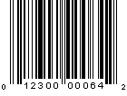
UPC-A
When specifying UPC-A messages, you normally specify 11 digits and let your bar code printing software calculate the 12th check digit for you. (All TALtech bar code software products automatically calculate check digits for you.)

Slide 25

UPC-E
UPC-E is a smaller seven digit UPC symbology for number system 0. It is often used for small retail items. For UPC-E bar codes, you normally specify 6 digits and let your bar code printing software calculate the seventh check digit for you.

Slide 26
Differences between Type A and Type E
UPC-E is also called "zero suppressed UPC" because UPC-E compresses a normal 12 digit UPC-A number into a six digit code by "suppressing" the number system digit, trailing zeros in the manufacturers code and leading zeros in the product identification part of the bar code message. A seventh check digit is encoded into a parity pattern for the six main digits. UPC-E can thus be uncompressed back into a standard UPC-A 12 digit number. Most bar code readers can be configured to automatically convert 6 digit UPC-E numbers to 12 digit UPC-A numbers before they are transmitted to a host computer.

Slide 27
Differences between Type A and Type E
The main difference between a UPC-A symbol and a UPC-E symbol is the size. Below is a UPC-A bar code on the left and the same data encoded as a UPC-E symbol on the right :

Slide 28
EAN-8/EAN-13 with supplemental (ISBN Version)
EAN or European Article Numbering system (also called JAN in Japan) is a European version of UPC. It uses the same size requirements and a similar encoding scheme as for UPC codes.
EAN-8 encodes 8 numeric digits consisting of two country code digits, five data digits and one check digit. B-Coder will accept up to 7 numeric digits for EAN-8. B-Coder will automatically calculate the check digit for you. If you enter less than 7 digits or if you enter any digits other than 0 to 9, B-Coder will display a warning message

Slide 29

EAN-8
EAN bar code numbers are assigned to specific products and manufacturers by an organization called ICOF located in Brussels, Belgium.

Slide 30

EAN 13
EAN -13 is the European version of UPC-A. The difference between EAN-13 and UPC-A is that EAN-13 encodes a 13th digit into the parity pattern of the left six digits of a UPC-A symbol. This 13th digit, combined with the 12th digit, usually represent a country code.

Slide 31
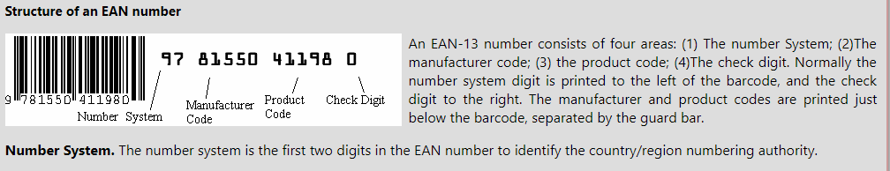
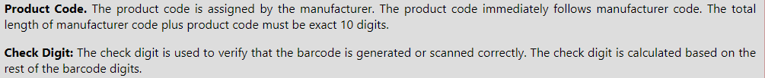
EAN 13

Slide 32
ISBN
EAN-13 has been adopted as the standard in the publishing industry for encoding ISBN numbers on books. An ISBN or BookLand bar code is simply an EAN-13 symbol consisting of the first 9 digits of the ISBN number preceded by the digits 978. The supplemental in an ISBN bar code is the retail price of the book preceded by the digit 5. For example, if your ISBN number is 1-56276-008-4 and the price of the book is $29.95 then you would enter 978156276008 as the bar code message and 52995 for the supplemental.
Notes:
ISBN-International Standard Book Number

Slide 33

CODE 93
CODE 93 is a variable length symbology that can encode the complete 128 ASCII character set. CODE 93 was developed as an enhancement to the Code 39 symbology by providing a slightly higher character density than Code 39. CODE 93 also incorporates two check digits as an added measure of security.

Slide 34
CODE 128
Code 128 is a variable length, high density, alphanumeric symbology. Code 128 has 106 different bar and space patterns and each pattern can have one of three different meanings, depending on which of three different character sets is employed. Special start characters tell the reader which of the character sets is initially being used and three special shift codes permit changing character sets inside a symbol. One character sets encodes all upper case and ASCII control characters, another encodes all upper and lower case characters and the third set encodes numeric digit pairs 00 through 99.

Slide 35

CODE 128

Slide 36
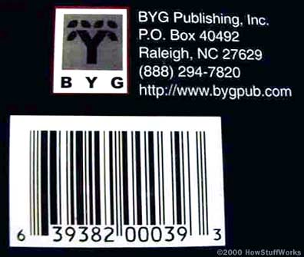
How UPC Bar Codes Work ?
"UPC" stands for Universal Product Code.

Slide 37
How UPC Bar Codes Work ?..
UPC symbol printed on a package has two parts:
The machine-readable bar code
The human-readable 12-digit UPC number
Manufacturer identification number is the first six digits of the UPC number . The next five digits are the item number. A person employed by the manufacturer, called the UPC coordinator, is responsible for assigning item numbers to products, making sure the same code is not used on more than one product, retiring codes as products are removed from the product line, etc. In general, every item the manufacturer sells, as well as every size package and every repackaging of the item, needs a different item code. So a 12-ounce can of Coke needs a different item number than a 16-ounce bottle of Coke, as does a 6-pack of 12-ounce cans, a 12-pack, a 24-can case, and so on.

Slide 38
The UPC Symbol
Glancing at the UPC symbol, you can easily see that it is divided in half. In fact, a UPC symbol can be divided into seven parts.
The first part of a UPC symbol is the left guard pattern. This consists of two thin vertical lines a bit taller than the other bars. The guard pattern doesn't contribute to the actual code, but is simply an indicator to identify the start of a UPC symbol.
The second part of a UPC symbol is the number system digit, which indicates what type of product the symbol is identifying.

Slide 39
The UPC Symbol (Cont.)
The third part of a UPC symbol is the manufacturer's code. This consists of five numbers (and their corresponding bars) and identifies the product manufacturer.
The fourth part of a UPC symbol is the centre guard pattern which consists of two thin vertical lines a bit taller than the other bars. The centre guard pattern divides the symbol in half.
The fifth part of a UPC symbol is the product code. This consists of five numbers (and their corresponding bars) and identifies the product.
The sixth part of a UPC symbol is the check digit, whose value is based on a weighting of the other digits in the code (see below).
The seventh part of a UPC symbol is the right guard pattern, which serves the same purpose as the left guard pattern.

Slide 40
The Bars
The bars in a UPC symbol consist of two bars and two spaces for each digit to be encoded. These bars and spaces fit into seven modules and are unique for each digit. The encodation of a digit in the left half of the symbol is the logical opposite of the encodation of the same digits in the right half of the symbol. All of the left digits have odd parity (the sum of the bar module widths is odd) while all of the right digits have even parity (the sum of the bar module widths is even).

Slide 41
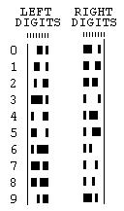
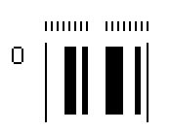
The Bars (Continued)

Slide 42
The Check Digit
The last digit of the UPC code is called a check digit. This digit lets the scanner determine if it scanned the number correctly or not.
The check digit is determined by the following function
3x1 + x2 + 3x3 + x4 + 3x5 + x6 + 3x7 + x8 + 3x9 + x10 + 3x11 + x12 ≡ 0 (mod 10).

Slide 43
The Check Digit (Continued)
a) Suppose that the first 11 digits of a UPC are 79357343104. What is the check digit?
(b) Is 041331021641 a valid UPC?
Solution: (a) We insert the digits of 79357343104 into the function for UPC
check digits. This gives 3.7+ 9+ 3.3 + 5 + 3.7 + 3 + 3.4+ 3+ 3.1 + 0 + 3.4+ x12 ≡ 0 (mod 10).
Simplifying, we have
21+ 9 + 9 + 5 + 21 + 3 + 12 + 3 + 3 + 0 + 12 +x12 ≡ 0(mod10).
Hence, 98 + x12 ≡ 0 (mod 10).
It follows that x12 ≡ 2 (mod 10),
So, the check digit is 2.

Slide 44
The Check Digit (Continued)
b) To check whether 041331021641 is valid, we insert the digits into the function these digits must satisfy.
This gives
3.0+ 4+ 3.1+ 3+ 3.3+ 1+ 3.0+ 2+ 3.1+ 6+ 3.4 +1
≡0 + 4 + 3 + 3 + 9 + 1 + 0 + 2 + 3 + 6 + 12 + 1
≡ 44
≡ 4 (mod 10).
≠ 0 (mod 10).
Hence, 041331021641 is not a valid UPC.

Slide 45
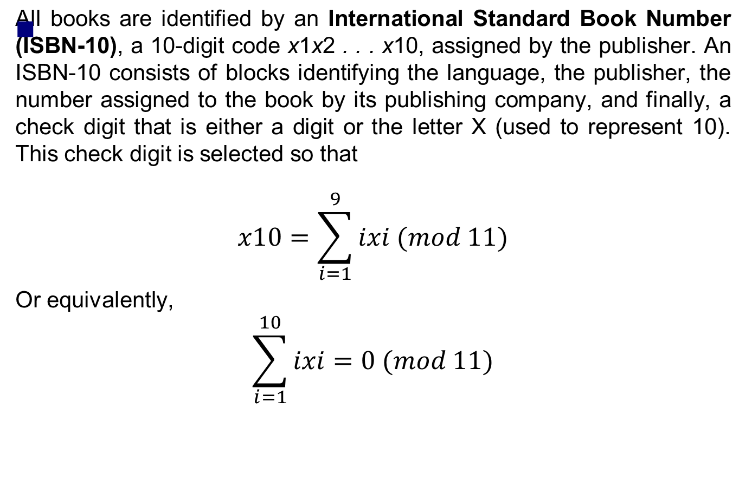
ISBN

Slide 46
ISBN
(a) The first nine digits of the ISBN-10 of the sixth edition of this book are 007288008. What is the check digit?
(b) Is 084930149X a valid ISBN-10?
Solution:
Inserting the digits 007288008 into the function gives
x10 ≡ 1.0+ 2.0+ 3.7+ 4.2+ 5.8+ 6.8+ 7.0+ 8.0 +9.8 (mod 11). x10 ≡ 0 + 0 + 21 + 8 + 40 + 48 + 0 + 0 + 72 (mod 11)
x10 ≡ 189
≡ 2 (mod 11).
Hence, x10 = 2.

Slide 47
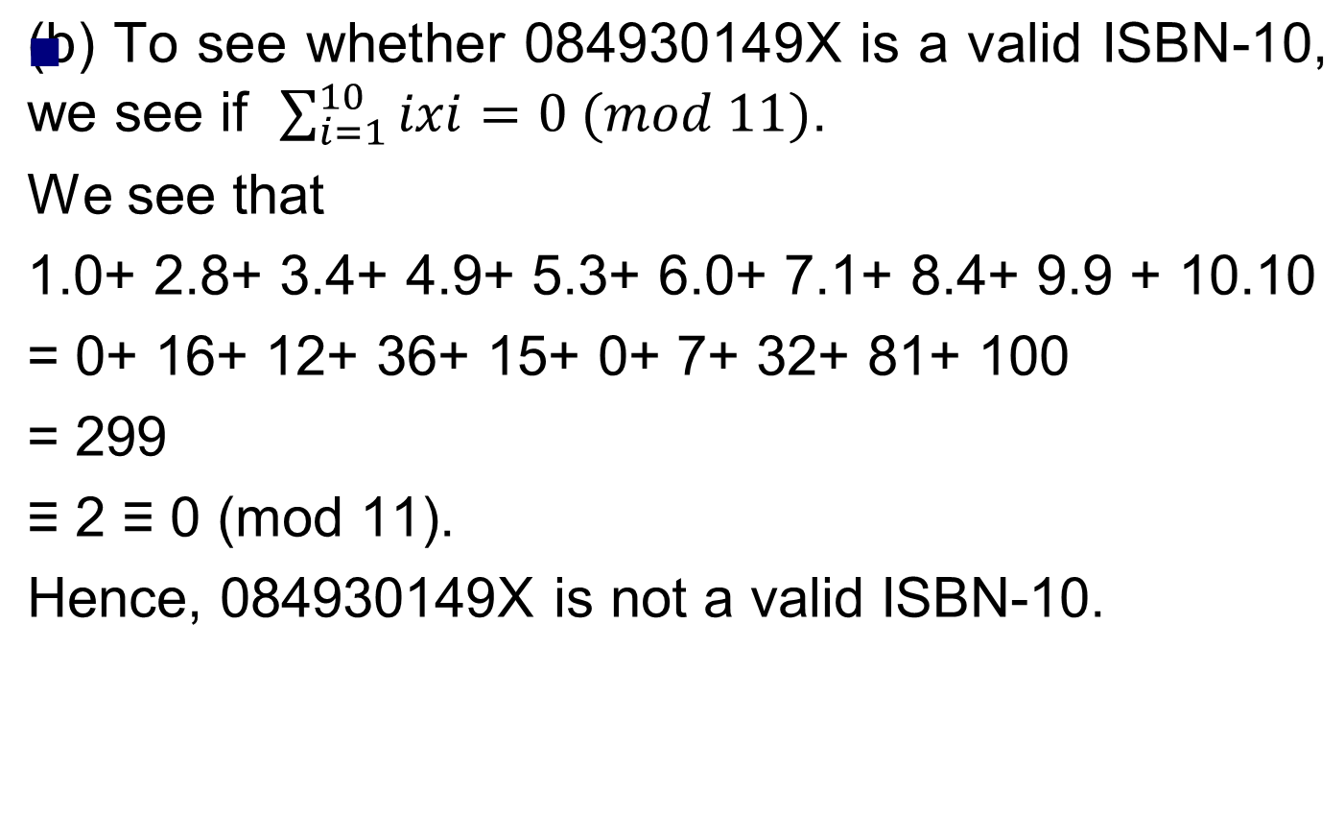
ISBN

Slide 48
How to decode a UPCA ?
There are twelve digits that make up the UPCA code. Each digit is represented by a seven bit binary code.
Use the code key, and if the binary code is 1 then it is represented by a black line. The 0 (zero) is a space (white).

Slide 49

How to decode a UPCA ?(Cont.)
Code Key :

Slide 50
How to decode a UPCA ?(Cont.)
There is a center code of five (5) lines, which are the digits 01010 which bisects the symbol.
The Start and End Code's are used by the scanner/computer to set the width of the binary digits within the symbol
On the left-hand side of the center code, use the left binary code. On the right-hand of the center code switch to the right binary code.See Table 1. This mirror image coding lets the scanner read the numbers in either direction.

Slide 51
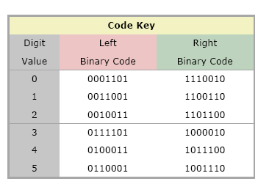
How to decode a UPCA ?(Cont.)
Table 1

Slide 52
How to decode a UPCA ?(Cont.)
The digits are encoded like this:
0 = 3-2-1-1 5 = 1-2-3-1
1 = 2-2-2-1 6 = 1-1-1-4
2 = 2-1-2-2 7 = 1-3-1-2
3 = 1-4-1-1 8 = 1-2-1-3
4 = 1-1-3-2 9 = 3-1-1-2
The start of any bar code is "1-1-1." That is, starting at the left you find a one-unit-wide black bar followed by a one-unit-wide white space followed by a one-unit-wide black bar (bar-space-bar).

Slide 53
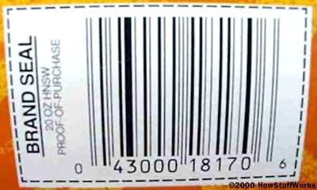
How to decode a UPCA ?(Example.)
Let's take this barcode as an example:

